Slide 1
One-sample mean with the t-distribution

Slide 2
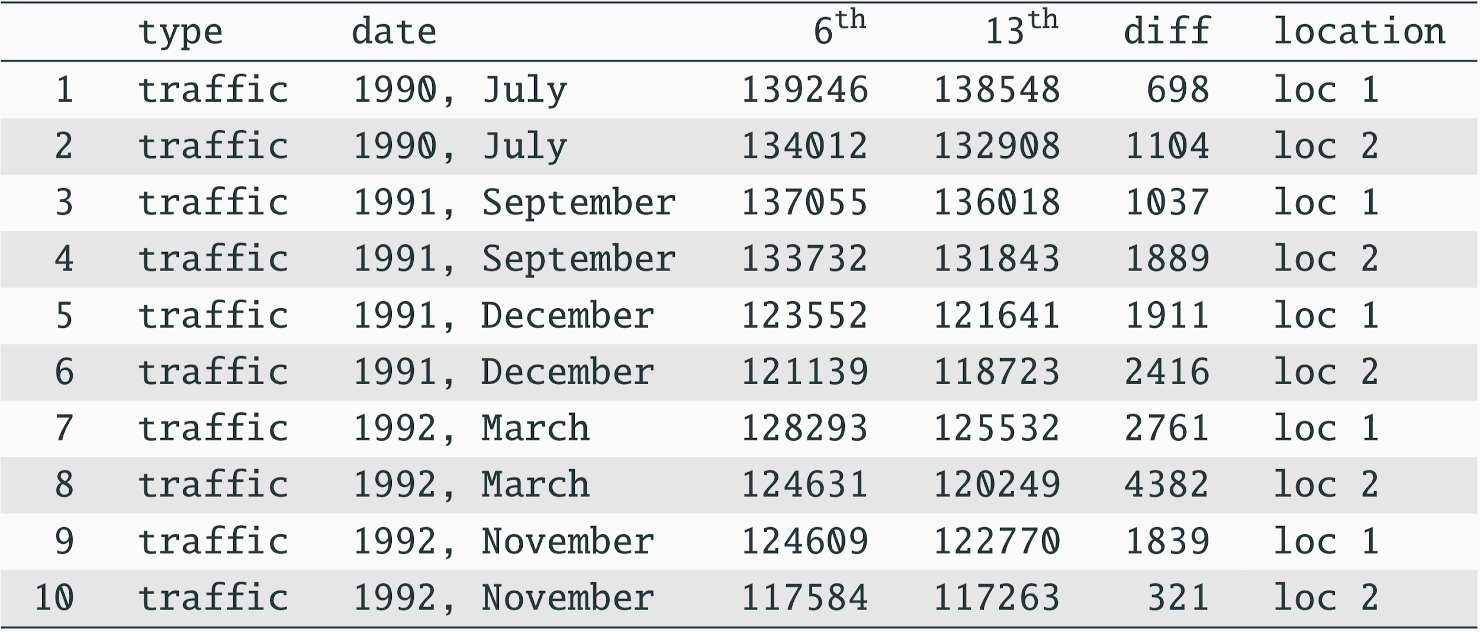
Friday the 13th
Between 1990 - 1992 researchers in the UK collected data on traffic flow, accidents, and hospital admissions on Friday 13th and the previous Friday, Friday 6th. Below shows the data set on traffic flow. We can assume that traffic flow on given day at locations 1 and 2 are independent.

Slide 3
Friday the 13th
We want to investigate if people’s behavior is different on Friday the 13th compared to Friday 6th.
One approach is to compare the traffic flow on these two days.
H₀ : Average traffic flow on Friday 6th and 13th are equal.
H_{A} : Average traffic flow on Friday 6th and 13th are different.

Slide 4
Friday the 13th
Each case in the data set represents traffic flow recorded at the same location in the same month of the same year: one count from Friday 6th and the other Friday 13th. Are these two counts independent?
Notes:
NO

Slide 5

Hypotheses
What are the hypotheses for testing for a difference between the average traffic flow between Friday 6th and 13th?
H₀ : 𝞵_{6th} = 𝞵_{13th} H_{A} : 𝞵_{6th} ≠ 𝞵_{13th}
H₀ : 𝙥_{6th} = 𝙥_{13th} H_{A} : 𝙥_{6th} ≠ 𝙥_{13th}
H₀ : 𝞵_{diff} = 0 H_{A} : 𝞵_{diff} ≠ 0
H₀ : = 0 H_{A} : ≠ 0

Slide 6
Hypotheses
What are the hypotheses for testing for a difference between the average traffic flow between Friday 6th and 13th?
H₀ : 𝞵_{6th} = 𝞵_{13th} H_{A} : 𝞵_{6th} ≠ 𝞵_{13th}
H₀ : 𝙥_{6th} = 𝙥_{13th} H_{A} : 𝙥_{6th} ≠ 𝙥_{13th}
H₀ : 𝞵_{diff} = 0 H_{A} : 𝞵_{diff} ≠ 0
H₀ : = 0 H_{A} : ≠ 0

Slide 7
Conditions
Independence: We are told to assume that cases (rows) are independent

Slide 8
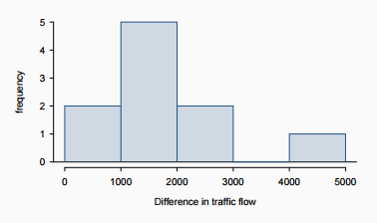
Conditions
Independence: We are told to assume that cases (rows) are independent
Sample size / skew:
The sample distribution does not appear to be extremely skewed, but it’s very difficult to assess with such a small sample size. We might want to think about whether we would expect the population distribution to be skewed or not probably not, it should be equally likely to have days with lower than average traffic and higher than average traffic.
It makes sense that the population distribution is not very different from a normal distribution.

Slide 9
The normality condition
The CLT, which states that sampling distributions will be nearly normal, hold true for any sample size as long as the population distribution is nearly normal

Slide 10
The normality condition
The CLT, which states that sampling distributions will be nearly normal, hold true for any sample size as long as the population distribution is nearly normal
We should exercise caution when verifying the normality condition for small samples. It is important to not only examine the data but also think about where the data come from
For example, ask: would I expect this distribution to be symmetric, and am I confident that outliers are rare?

Slide 11
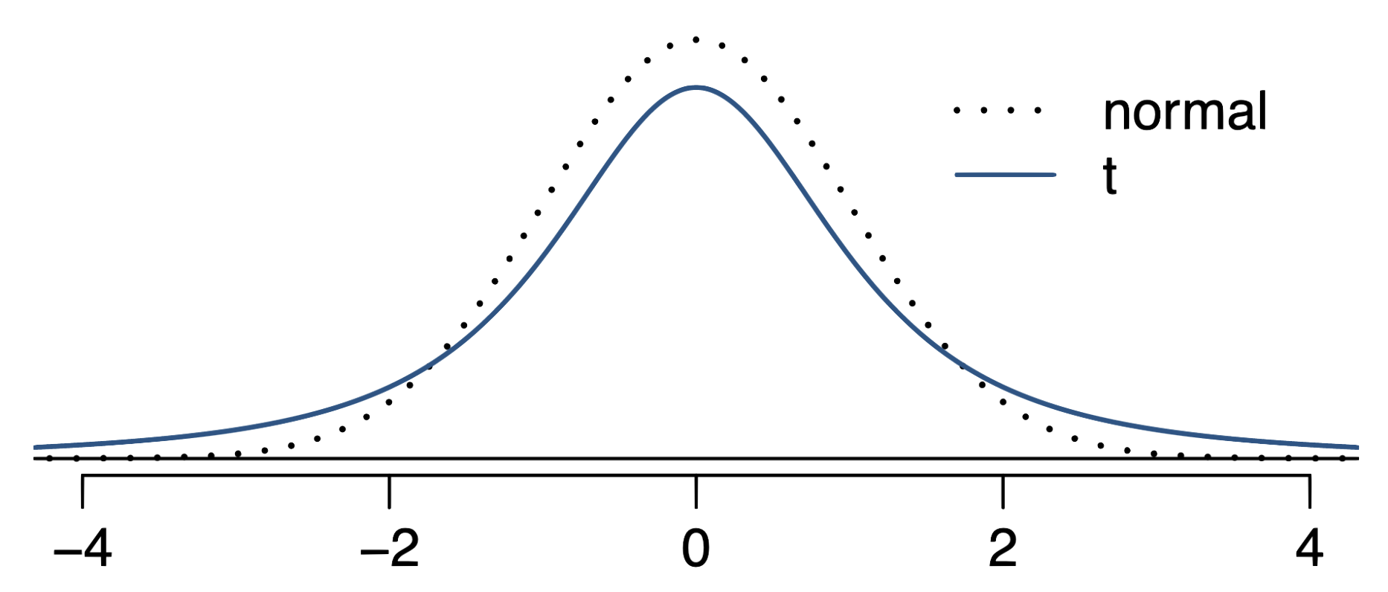
The 𝒕 distribution
When the population standard deviation σ is unknown (almost always), the uncertainty of the SE estimate is addressed by using a new distribution: the 𝒕 distribution.
This t distribution also has a bell shape, but it’s flatter than the standard normal curve.

Slide 12
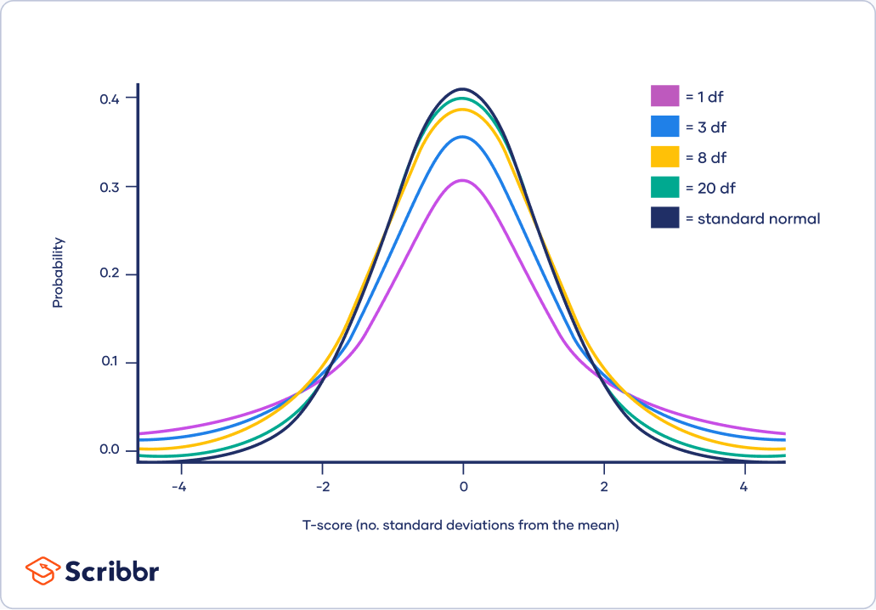
The 𝒕 distribution (cont.)
Always centered at zero, like the standard normal (𝓏) distribution
Has a single parameter: degrees of freedom (df).

Slide 13
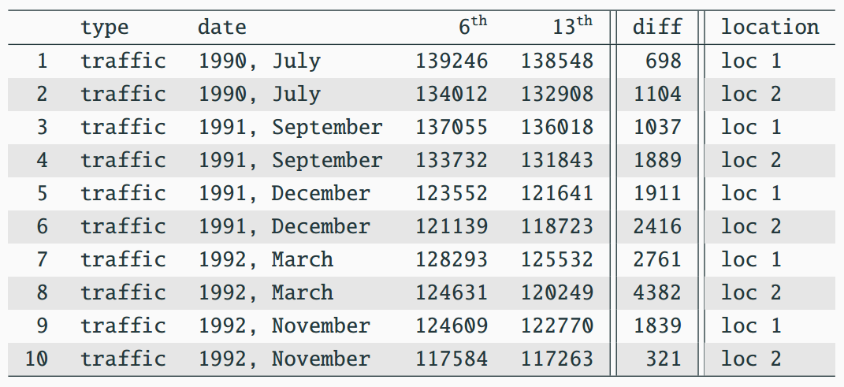


Back to Friday the 13th

Slide 14
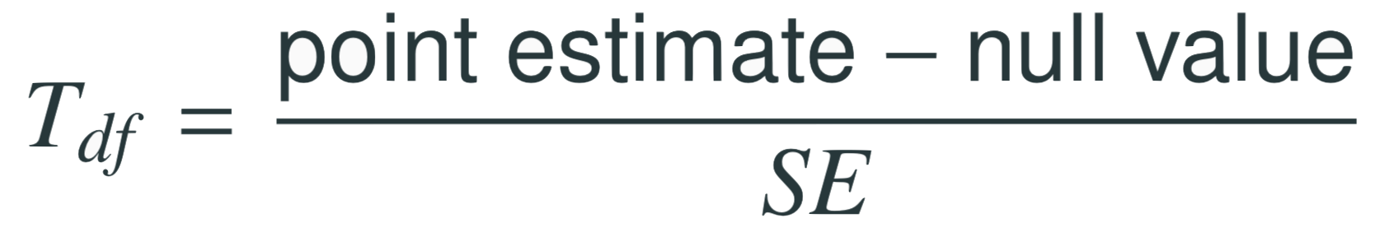
Find the test statistic
Test statistic for inference on a small sample mean
The 𝑇 test statistic has df = n – 1.

Slide 15
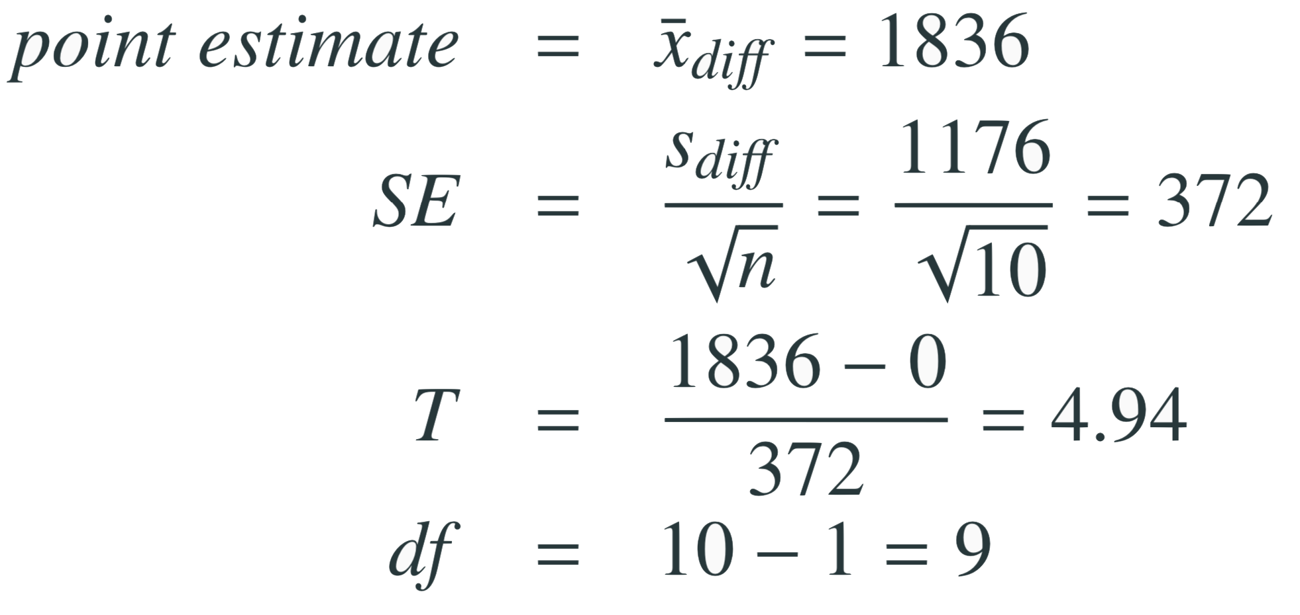
Find the test statistic
Test statistic for inference on a small sample mean
The 𝑇 test statistic has df = n – 1.
in context...
Note: Null value is 0 because in the null hypothesis we set 𝞵_{diff} = 0

Slide 16
Finding the p-value
The p-value is, once again, calculated as the area under the tail of the 𝒕 distribution

Slide 17
Finding the p-value
The p-value is, once again, calculated as the area under the tail of the 𝒕 distribution
Using R:
> 2 * pt(4.94, df = 9, lower.tail = FALSE)
[1] 0.0008022394
Using a web app:
http://gallery.shinyapps.io/dist_calc/

Slide 18
Conclusion of the test
What is the conclusion of this hypothesis test?
Since the p-value is lower than α which is 0.05 by default, we reject Ho. So the data provide strong evidence of a difference between traffic flow on Friday 6th and 13th.

Slide 19
What is the difference?
We concluded that there is a difference in the traffic flow between Friday 6th and 13th
But it would be more interesting to find out what exactly this difference is

Slide 20
What is the difference?
We concluded that there is a difference in the traffic flow between Friday 6th and 13th
But it would be more interesting to find out what exactly this difference is
We can use a confidence interval to estimate this difference

Slide 21

Confidence interval for a small sample mean
Confidence intervals are always of the form

Slide 22
Confidence interval for a small sample mean
Confidence intervals are always of the form
ME is always calculated as the product of a critical value and SE

Slide 23
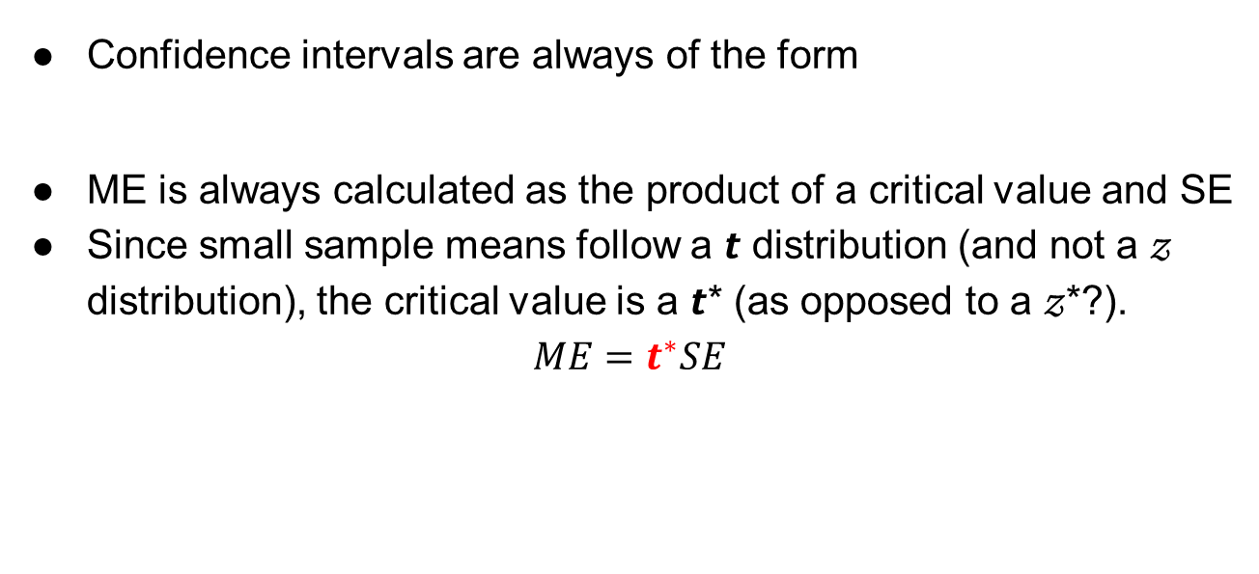
Confidence interval for a small sample mean
Confidence intervals are always of the form
ME is always calculated as the product of a critical value and SE
Since small sample means follow a 𝙩 distribution (and not a 𝓏 distribution), the critical value is a 𝙩* (as opposed to a 𝓏*?).
$$ME=t^{∗}SE$$

Slide 24
Finding the critical value (t★)
Using R:
> qt(p = 0.975, df = 9)
[1] 2.262157

Slide 25
Constructing a CI for a small sample mean
Which of the following is the correct calculation of a 95% confidence interval for the difference between the traffic flow between Friday 6th and 13th?
1836 ± 1.96 x 372
1836 ± 2.26 x 372
1836 ± -2.26 x 372
1836 ± 2.26 x 1176

Slide 26
Constructing a CI for a small sample mean
Which of the following is the correct calculation of a 95% confidence interval for the difference between the traffic flow between Friday 6th and 13th?
1836 ± 1.96 x 372
1836 ± 2.26 x 372 (995, 2677)
1836 ± -2.26 x 372
1836 ± 2.26 x 1176

Slide 27

Interpreting the CI
Which of the following is the best interpretation for the confidence interval we just calculated?
We are 95% confident that…
the difference between the average number of cars on the road on Friday 6th and 13th is between 995 and 2,677
on Friday 6th there are 995 to 2,677 fewer cars on the road than on the Friday 13th, on average
on Friday 6th there are 995 fewer to 2,677 more cars on the road than on the Friday 13th, on average
on Friday 13th there are 995 to 2,677 fewer cars on the road than on the Friday 6th, on average

Slide 28
Interpreting the CI
Which of the following is the best interpretation for the confidence interval we just calculated?
We are 95% confident that…
the difference between the average number of cars on the road on Friday 6th and 13th is between 995 and 2,677
on Friday 6th there are 995 to 2,677 fewer cars on the road than on the Friday 13th, on average
on Friday 6th there are 995 fewer to 2,677 more cars on the road than on the Friday 13th, on average
on Friday 13th there are 995 to 2,677 fewer cars on the road than on the Friday 6th, on average

Slide 29
Synthesis
Does the conclusion from the hypothesis test agree with the findings of the confidence interval?
Do you think the findings of this study suggests that people believe Friday 13th is a day of bad luck?

Slide 30



Recap: Inference using the 𝒕-distribution
If 𝞼 is unknown, use the 𝒕-distribution with
Conditions:
Independence of observations
Large n or no extreme skew
Hypothesis Testing:
Confidence interval:

